Slide 1
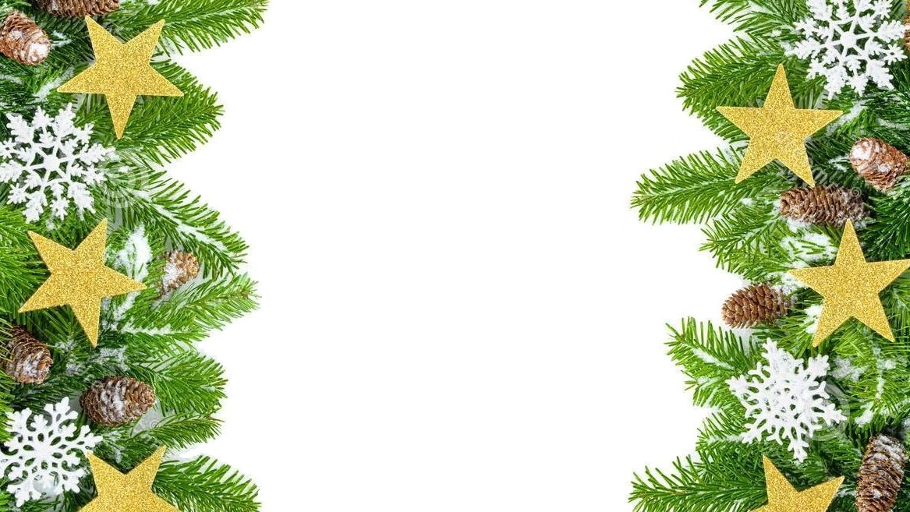
Christmas

Slide 2
Christmas is a very important time in Poland. It’s the most family holiday. Christmas is celebrated for 3 days - 24, 25 and 26 December.
Preperation starts earlier. People clean up their flats, buy presents, send wishes and decorate Christmas trees with baubles, multi-coloured lights, tinsels and other decorations. The most important day of Christmas is Christmas Eve, celebrated on December 24. Traditionally, it is the time when a whole family gets together, celebrates, and rests. At this time a meatless Christmas Eve dinner is eaten.

Slide 3
Christmas Eve traditions
* Twelve dishes *
There should be twelve dishes on the Christmas Eve table in Poland. The number symbolizes the apostles of Jesus.

Slide 4
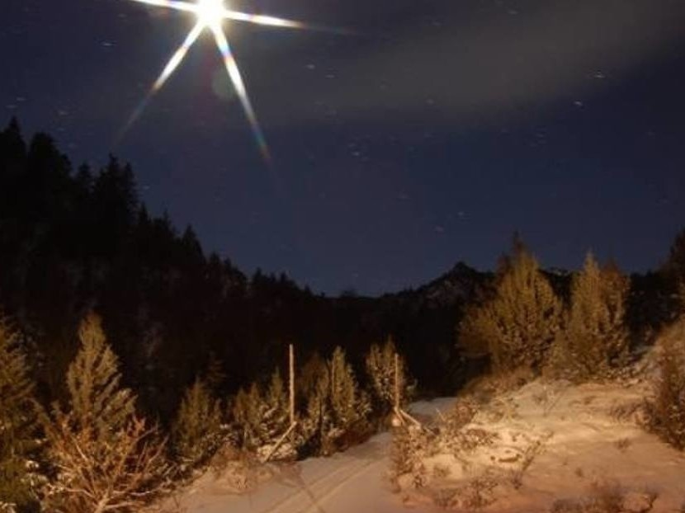
* Waiting for the first star to appear in the sky *
Many people in Poland wait until the first star appears in the sky before sitting down to eat on December 24th. This tradition comes from the Star of Bethlehem.

Slide 5
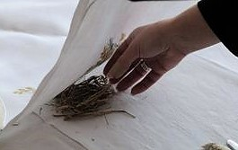
* Putting hay beneath the tablecloth *
The table is traditionally set with a white tablecloth under which some hay is put to commemorate the birth of Jesus Christ.

Slide 6
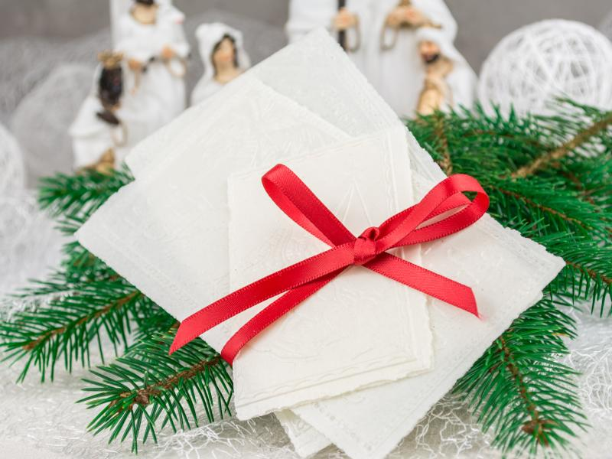
* Sharing the wafer *
Every person attending the Christmas Eve celebration gets one wafer and then shares pieces of it with everyone else. This is accompanied by exchanges
of good wishes and occurs before sitting
down to eat.
This tradition is related to the breaking of bread at the Last Supper.

Slide 7
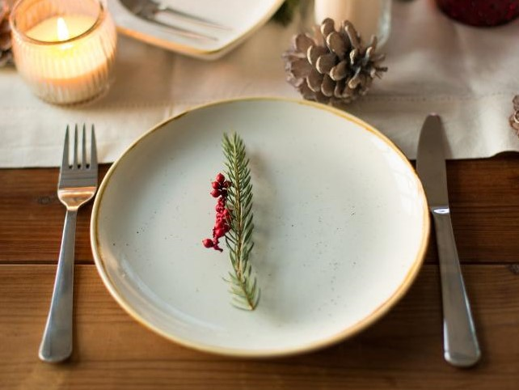
* Leaving one empty place at the table *
When everybody sits down at the table to taste the delicious Christmas dishes that must be one place still empty. This place is for unexpected guest.

Slide 8
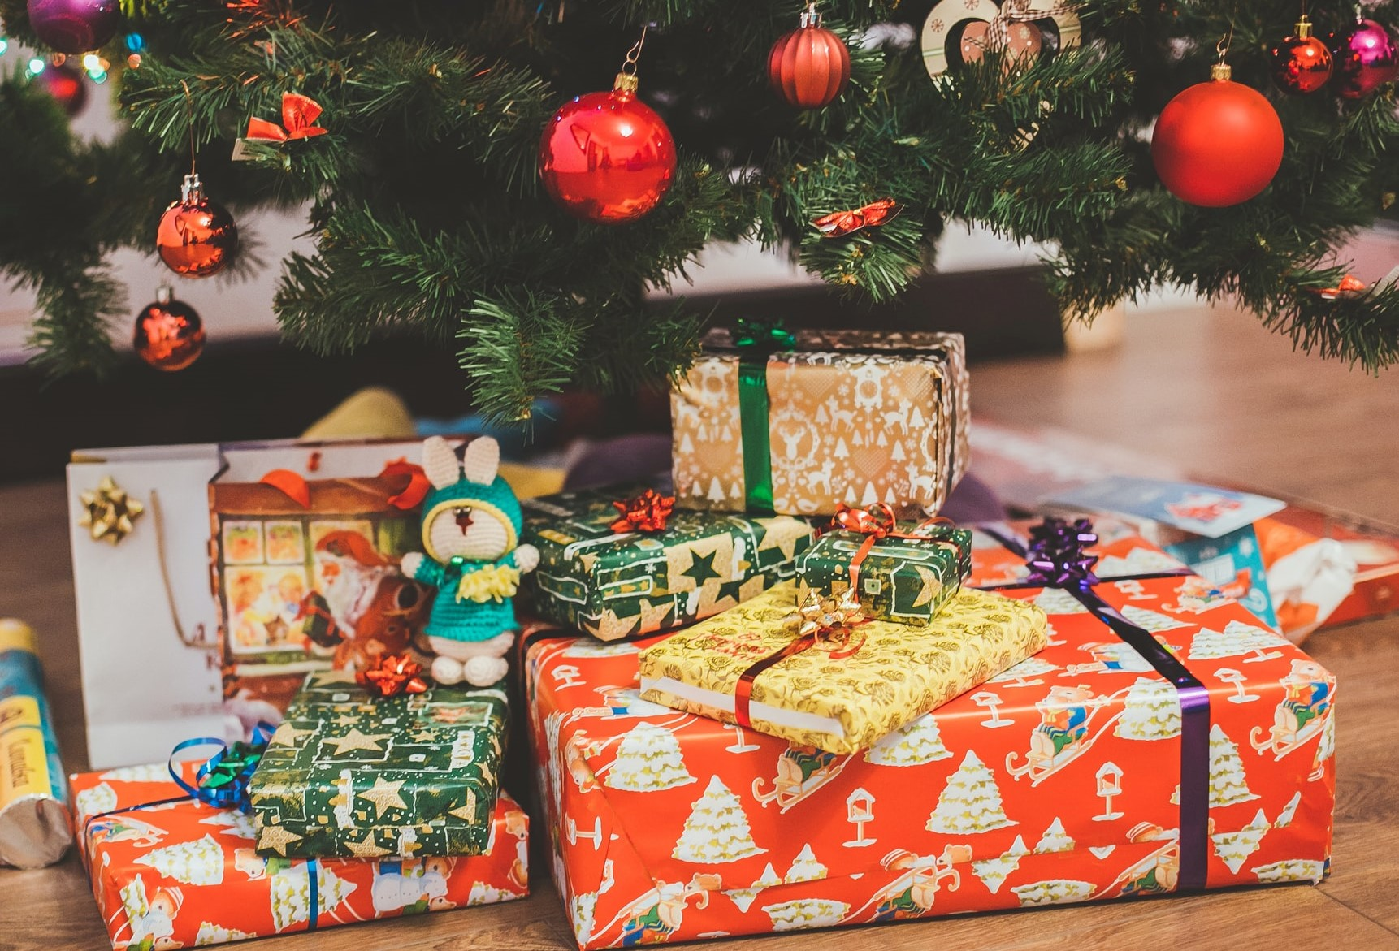
* Giving gifts *
For every Christmas Eve guest there are some presents under the Christmas tree.
Probably tradition of giving Christmas presents is related to the gifts that the kings offered to Jesus.

Slide 9
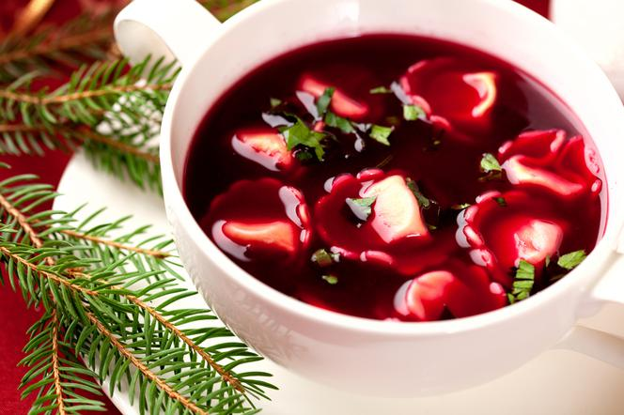
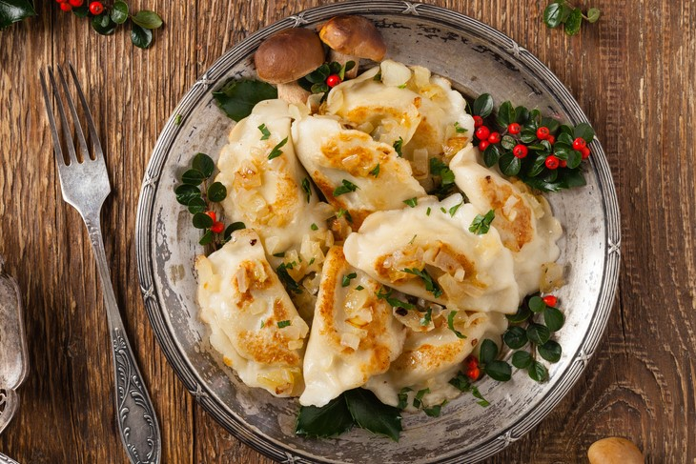
Traditional dishes
* Soup → It is either beetroot soup with mushroom-filled little dumplings or forest mushroom soup
* Dumplings with sauerkraut and forest mushrooms

Slide 10
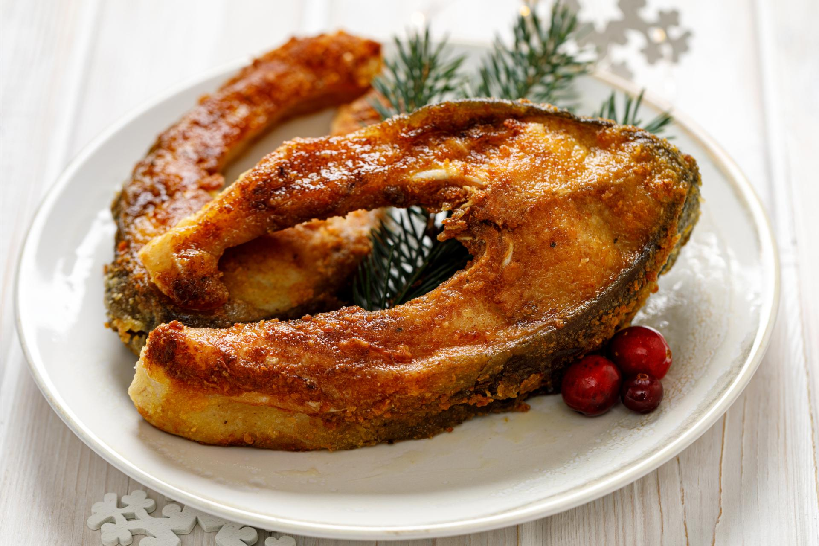
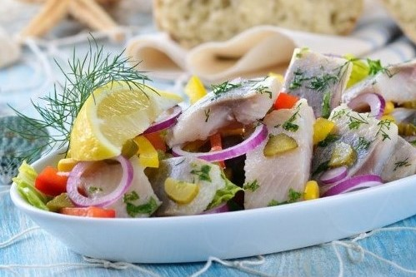
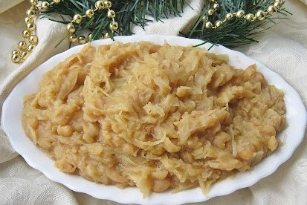
* Fish
→ especially carp fried or served in cold jelly
→ few types of herring: pickled herring, herring in oil or in sour cream
* Sauerkraut stewed with yellow peas

Slide 11
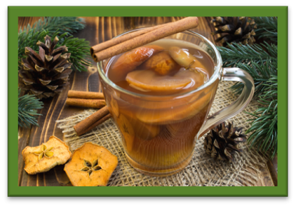
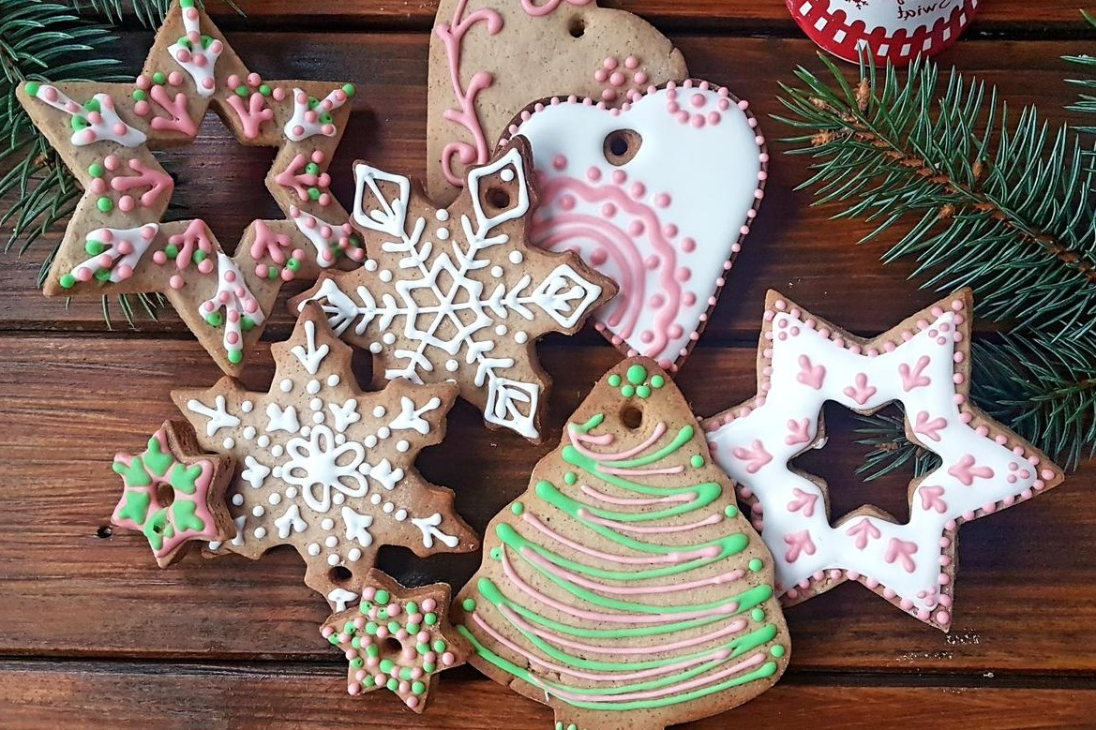
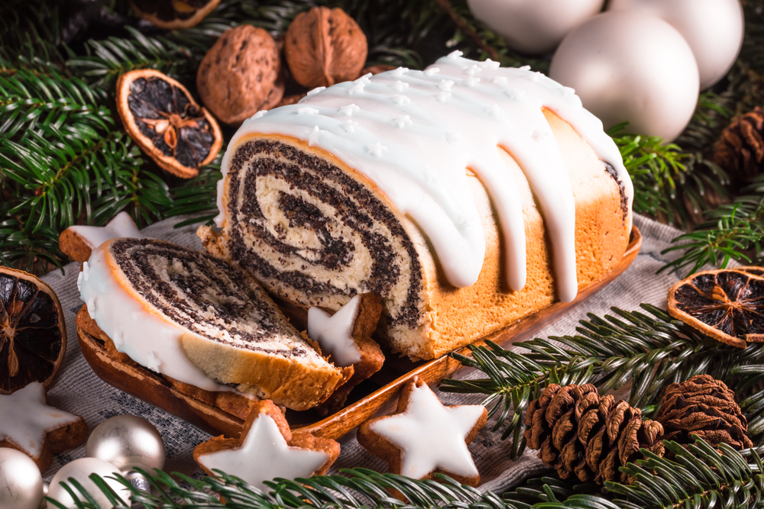
* Desserts → dessert made of poppy seed, wheat berries and honey called kutia. Gingerbreads, poppy seed cake and cheesecake
* Compote from dried fruits

Slide 12
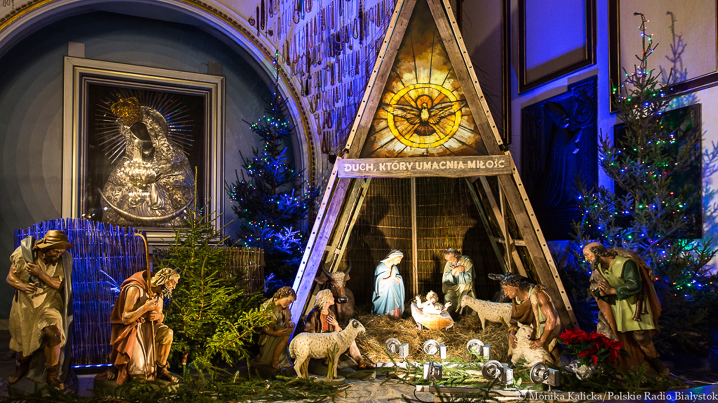
Two next Christmas days are free from school and work. Poles usually go to church, meet their family and visit relatives’ tombs.

Slide 13
The presentation
was made by
Eryk Kubicki
VIII b

