Slide 1
Christmas Traditions in Poland

Slide 2
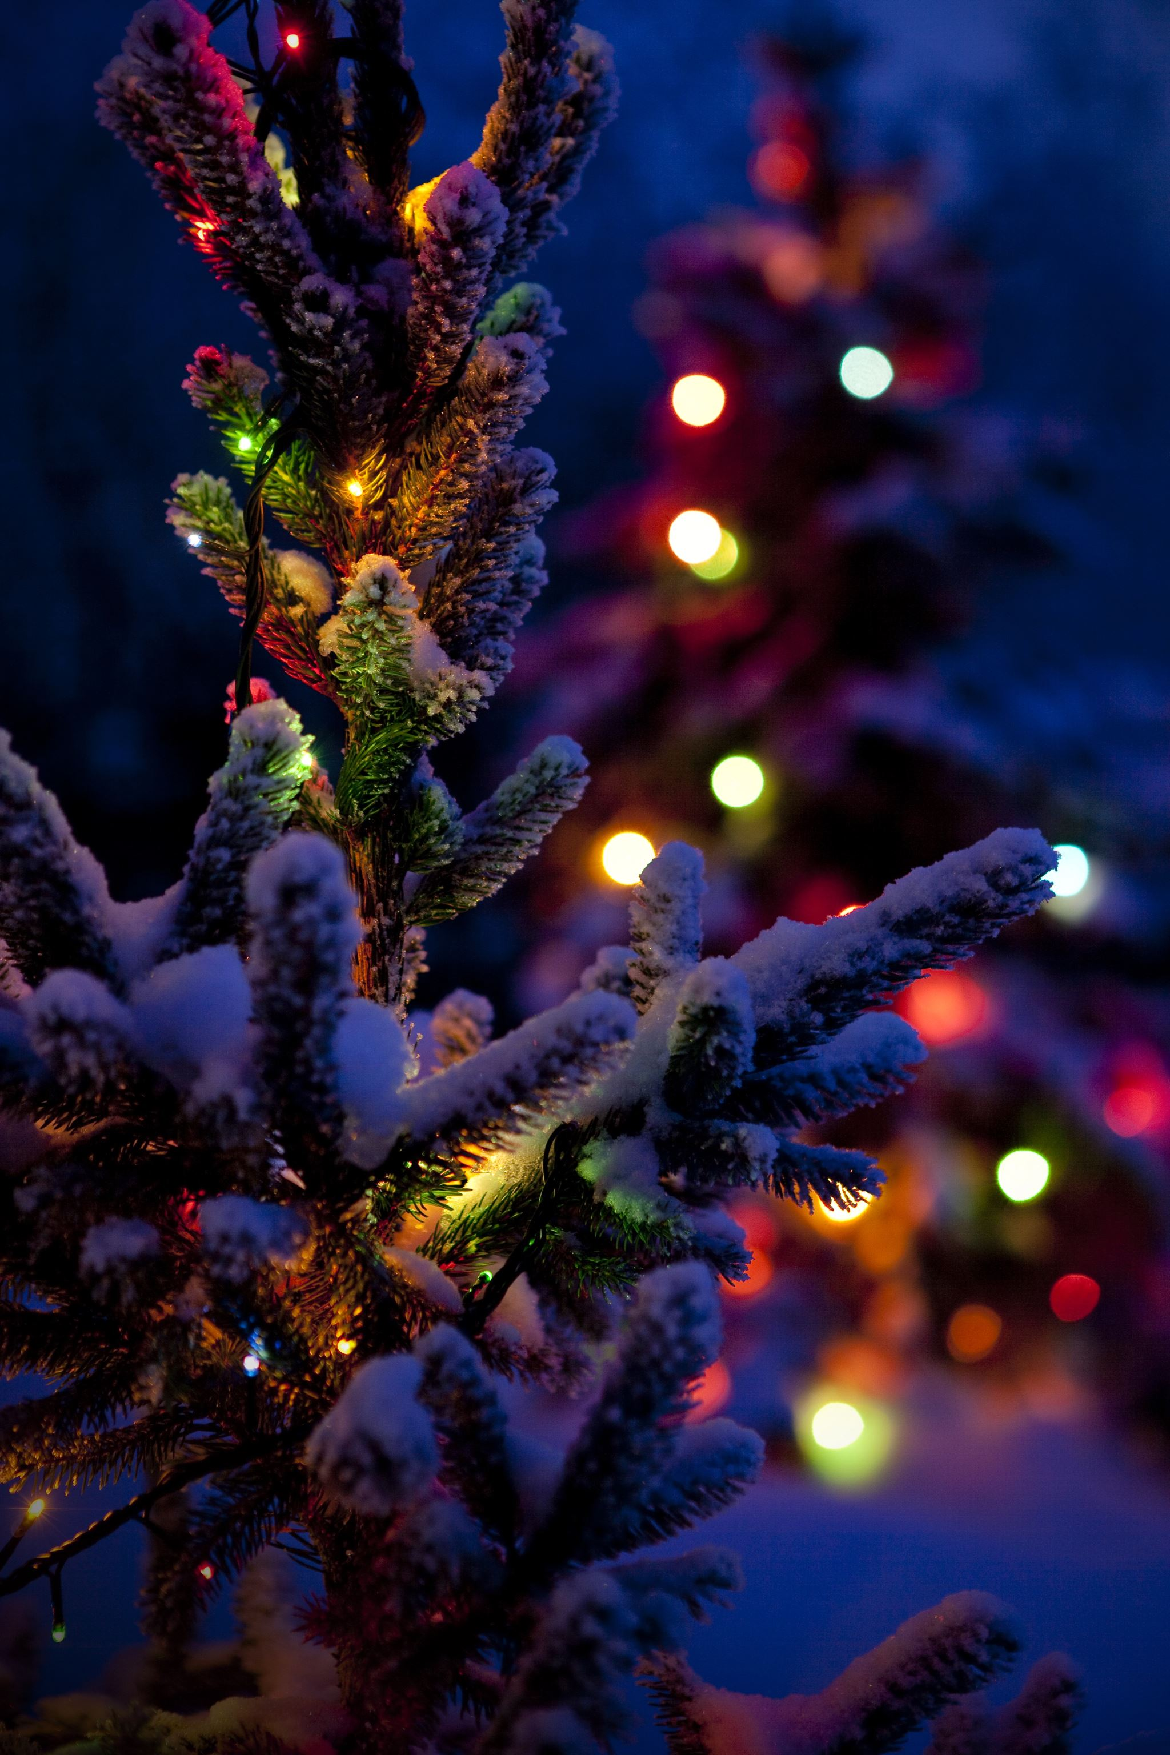
Decorating the christmas tree
Decorating a Christmas tree is a common practice during the holiday season. You can decorate the Christmas tree with various decorations, such as baubles, chains, lights and your own decorations. The Christmas tree symbolizes life and the color green represents hope.

Slide 3
sharing the wafer
the custom of breaking the wafer came from the first Christians who shared the bread as a sign that they were a community. The wafers were not only white, but also colored. The colorful ones were intended for animals, mainly cattle. After the Christmas Eve supper, the hostess collected the remnants of the dishes, added such a wafer to them and took them to the stable. It was believed that cows treated with it would be healthier and give more milk. It also meant that people wanted peace with all creation.

Slide 4
Chrismas carrols singing
singing Christmas carols is an important part of preparing for Christmas. We sing them with family, friends and with class. The most famous Christmas carols are;
-God is born
-Silent Night
-Today in betleyem
-Tiny Jesus
-Let's go all the stable.

Slide 5
Giving gifts
giving gifts gives a lot of happiness to the person who gives like the person who got it. The gifts are given on December 6 at the Christmas tree. This tradition is very much liked by children.
December 6 is one of the most enjoyable days of the year

Slide 6
12 Christmas Eve dishes
There should be 12 Christmas dishes on the Christmas table.
Tradition dictates that during the Christmas Eve dinner you should try all the dishes because it will ensure happiness for the whole new year
Christmas Eve dishes:
-Christmas Eve red borscht with .
-mushroom soup.
-Dumplings with cabbage and mushrooms.
-Stuffed cabbage with buckwheat and Mushrooms.
-Greek-style fish.
-Carp.

Slide 7
additional cover at the Christmas Eve table
always on Christmas Eve we leave one place for an unexpected guest an empty place at the table is one of the most important Christmas traditions, they were left for an unexpected guest to express our hospitality the symbol of an additional place for an unexpected guest means the memory of the dead or people who cannot spend Christmas Eve with us.

Slide 8
hay under the tablecloth
hay under the tablecloth provides good omen for the coming year.
According to some beliefs, the person who pulls out the longest and straight stalk will be the most lucky in the new year The practice of some people putting hay under the tablecloth has been severely criticized

Slide 9
the first star in the sky
A special moment of Christmas Eve is when children wait for their first star. When the first star appears, you should think your wishes and sit at the table on Christmas Eve, the first star is a symbol of the star of Bethlehem that heralded the the first star is eagerly awaited by childrenbirth of Jesus.

Slide 10
shepherdess
Midnight Mass is a solemn mass usually celebrated at midnight or in the evening hours of December 24-25. it commemorates the waiting and prayers of the shepherds on their way to Bethlehem. Pasterka is one of the most important Christmas traditions in Poland.

