Slide 1
Polish Christmas Eve Traditions
Ewa Hlebicka-Józefowicz

Slide 2
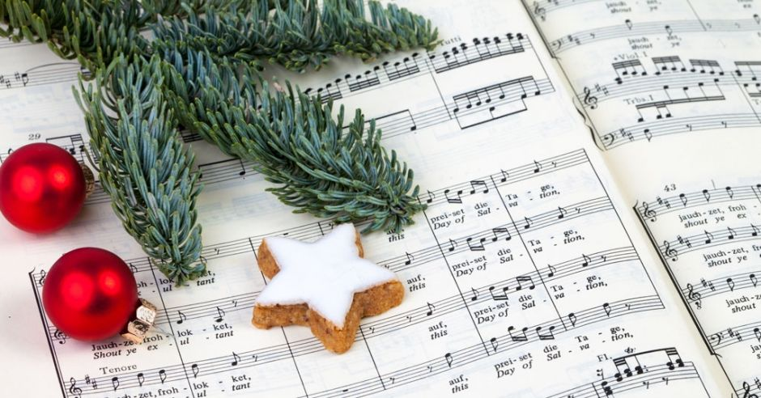
SINGING OF CHRISTMAS CAROLS
Most people listen to or sing Christmas carols. They are usually sung by whole families sitting around
the Christmas Eve table.
Some carols are cheerful, some are peaceful like lullabies.

Slide 3
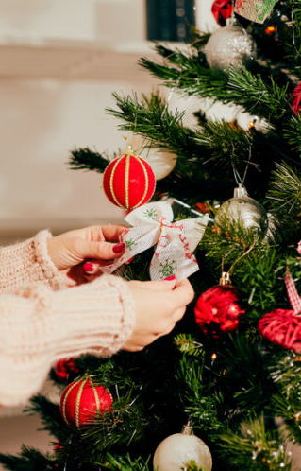
DECORATING CHRISTMAS TREE
This tradition appeared in Poland at the turn of the 18th and 19th centuries. People decorate Christmas trees just before Christmas Eve or a few days earlier. They hang chains, lamps, baubles on them.

Slide 4
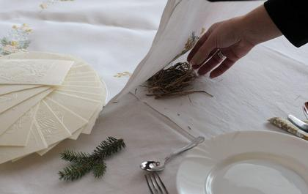
PUTTING HAY UNDER THE TABLECLOTH
Not everyone does it, but this tradition is still popular in Poland.
This symbolises the poverty in which Jesus was born
(in a stable on a hay).

Slide 5
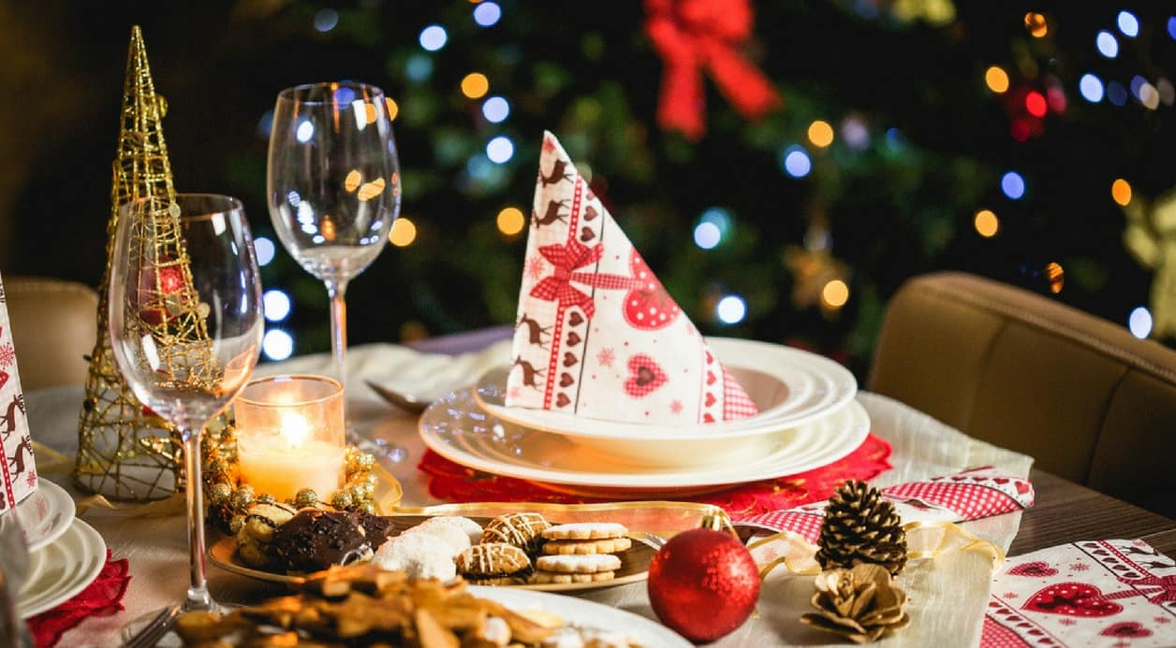
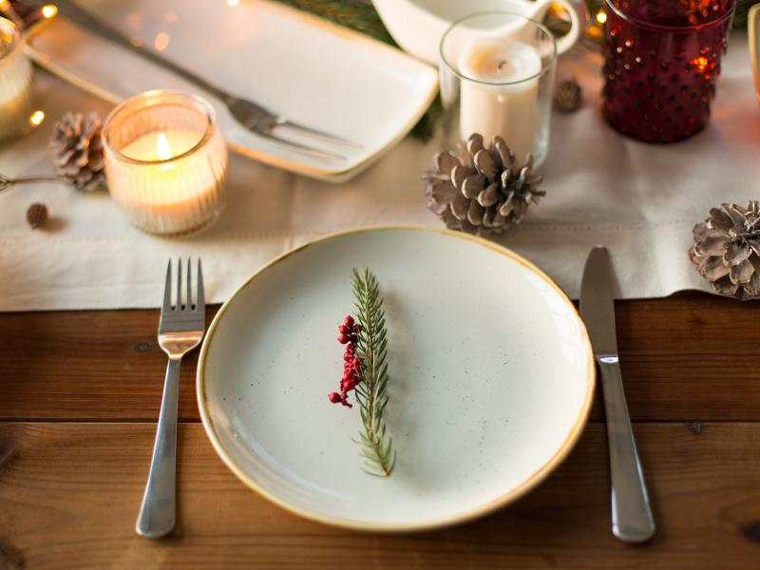
LEAVING ONE EMPTY SEAT
AT THE TABLE
During Christmas Eve people prepare a separate plate and cutlery for an unexpected guest, who may appear at any moment and join in the feast.

Slide 6
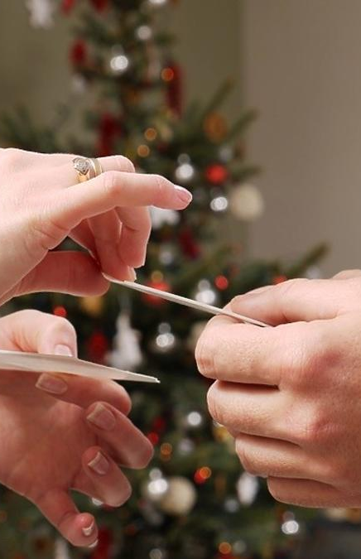
SHARING THE WAFER
The Christmas Eve feast begins with the sharing of the wafer and greetings to one another.
After you say your wish, you break a piece of the other person's wafer.

Slide 7
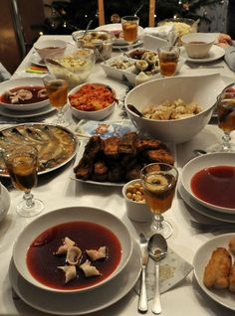
12 CHRISTMAS EVE DISHES
This is one of the most popular Polish Christmas traditions. There should be twelve dishes on the Christmas Eve table. The red borscht with mushrooms ravioli is the main one and is served first. Then you eat the carp or other fried fish. Herring with onions and dumplings with cabbage and mushrooms are also served.
Meat should not be eaten on Christmas Eve.

Slide 8
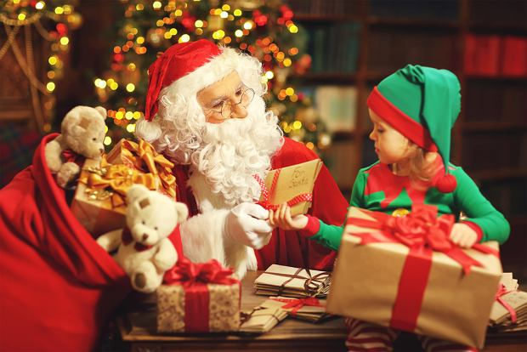
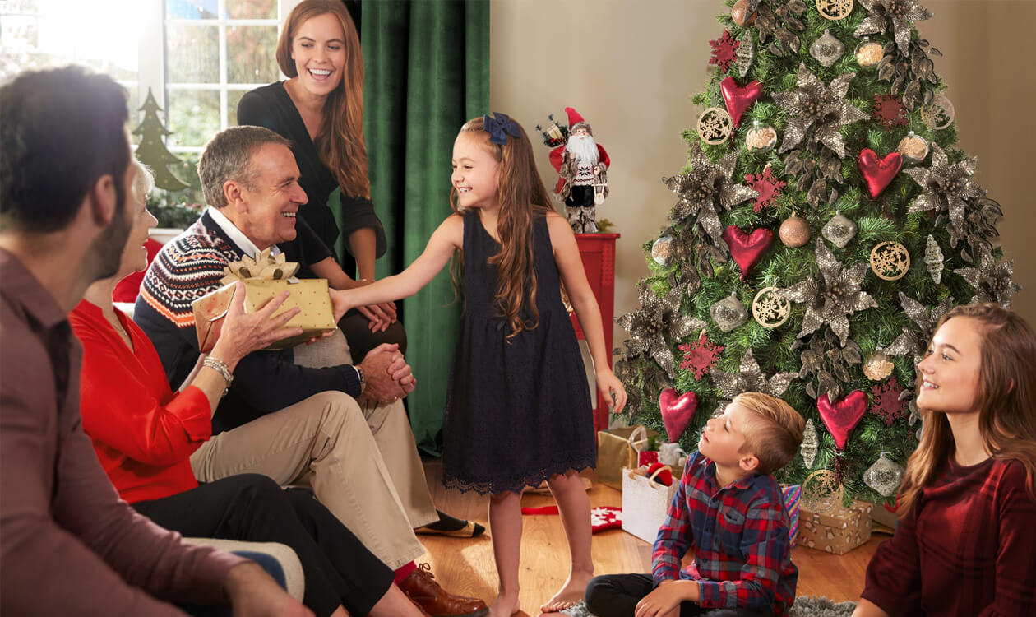
OPENING GIFTS
Gifts that lie under the Christmas Tree are usually opened at the end of Christmas Eve, after eating. Small children believe that Santa Claus or „The Star" brings them.
☺

Slide 9
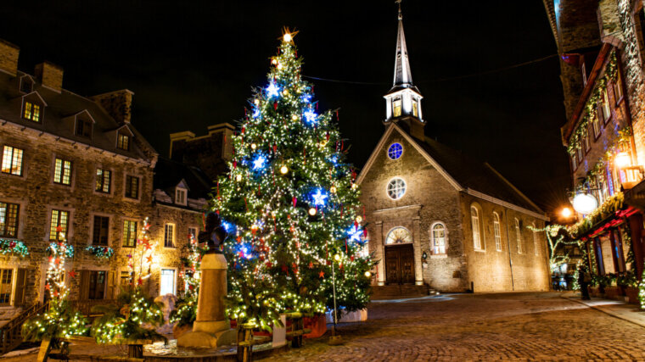
MIDNIGHT MASS
People go to Midnight Mass after Christmas Eve.
It symbolises the birth of Jesus at night. The Midnight Mass commemorates the waiting and prayers of the shepherds on their way to Bethlehem.
Mainly carols are sung on it.

Slide 10
The end…
Thank You For Your Attention!
Ewa Hlebicka-Józefowicz, 8 c

